Slide 1




Real Time Weather App

Slide 2
Team Members
Akash Pal
Aviral Srivastava
Akshay Singh

Slide 3
Introduction
Our project titled as "Real Time Weather App" is basically a web based application used to inform the user about the climate condition, atmospheric predictions and any updates on the weather.
It is the best medium to know the any upcoming weather patterns in the environment. If a person is planning a trip to any destination, he can know the weather of that destination in advance.
There are several benefits of using the weather apps, rather than relying on the regular news broadcasts. It makes information available 24*7 in a few taps.

Slide 4
Advantage of Weather Forecasting Website
Available at any time
Improved Weather forecast
Easy Flow of Information
Widget support
Interactive Maps for better weather information
Free availability

Slide 5
Functional Requirements
Enter the location : The user must enter the location to view the desired weather parameters
Input the time-period: The user shall be able to input the time-period for he want to know the weather parameters.
The system should be able to provide the following weather parameters :Temperature, Pressure, Humidity, Wind Speed and Air Quality.

Slide 6
Non- Functional Requirements
The interface gives the response in less than 10seconds.
The system should support 500 requests/min.
The system must be secure.
The system should be maintainable so that if any change occur,
It does not effect.
The system should be easy to use for users.

Slide 7
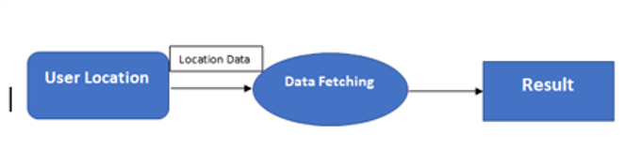
Data Flow Diagram
Level ‘0’

Slide 8
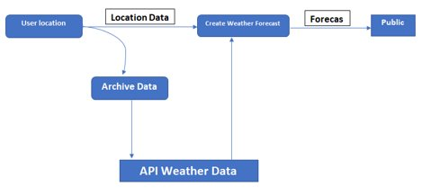
Data Flow Diagram
Level ‘1’

Slide 9
Data Flow Diagram
Level ‘1’

Slide 10
Gantt Chart
Procedures​ | Week 1​ | Week 2​ | Week 3​ | Week 4​ | Week 5​ | Week 6​
Requirement Analysis​ | ​ | ​ | ​ | ​ | ​ | ​
Design​ | ​ | ​ | ​ | ​ | ​ | ​
Implementation (Coding)​ | ​ | ​ | ​ | ​ | ​ | ​
Testing​ | ​ | ​ | ​ | ​ | ​ | ​
Maintenance​ | ​ | ​ | ​ | ​ | ​ | ​
z

Slide 11

Thank You!!!!!

